Slide 1

Decision Change
A Plan for a Plan for the Planet
Arnold J. Bomans
Pre-recorded on August 5, 2025 for the Second Global Summit on Climate Change & Environmental Sustainability, September 18-19, 2025 https://climatechangeconferences.org/
Previously delivered at the Global Climate Change and Biodiversity Congress, August 4, 2025 https://globalccbcongress.com/

Slide 2
More information
2/11
Arnold J. Bomans and Peter Roessingh (2024) Decision Change: the First Step to System Change. Sustainability, vol. 16, no.6, 2372; https://doi.org/10.3390/su16062372
www.decisionchange.net
decisionchange@gmail.com

Slide 3
Contents
3/11
Problems
System change
Decision making
Decision change
Coordination
Discussion
Action

Slide 4
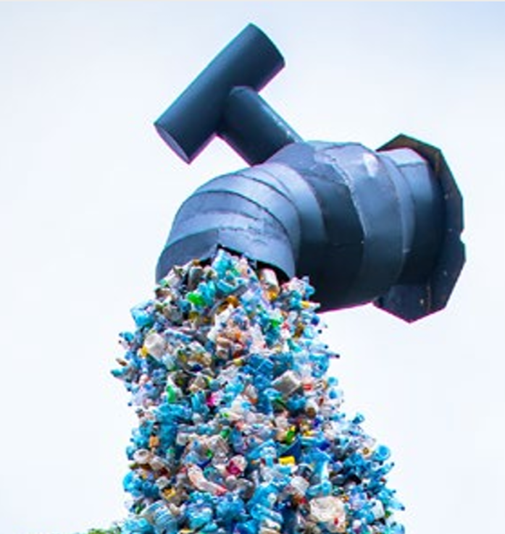
System change
4/11
The Giant Plastic Tap.
Installation by Benjamin von Wong.*
* Detail of photo by the United Nations Environment Programme, from the front page of its report ‘Turning off the Tap. How the world can end plastic pollution and create a circular economy.’ Nairobi, 2023. https://www.unep.org/resources/turning-off-tap-end-plastic-pollution-create-circular-economy

Slide 5
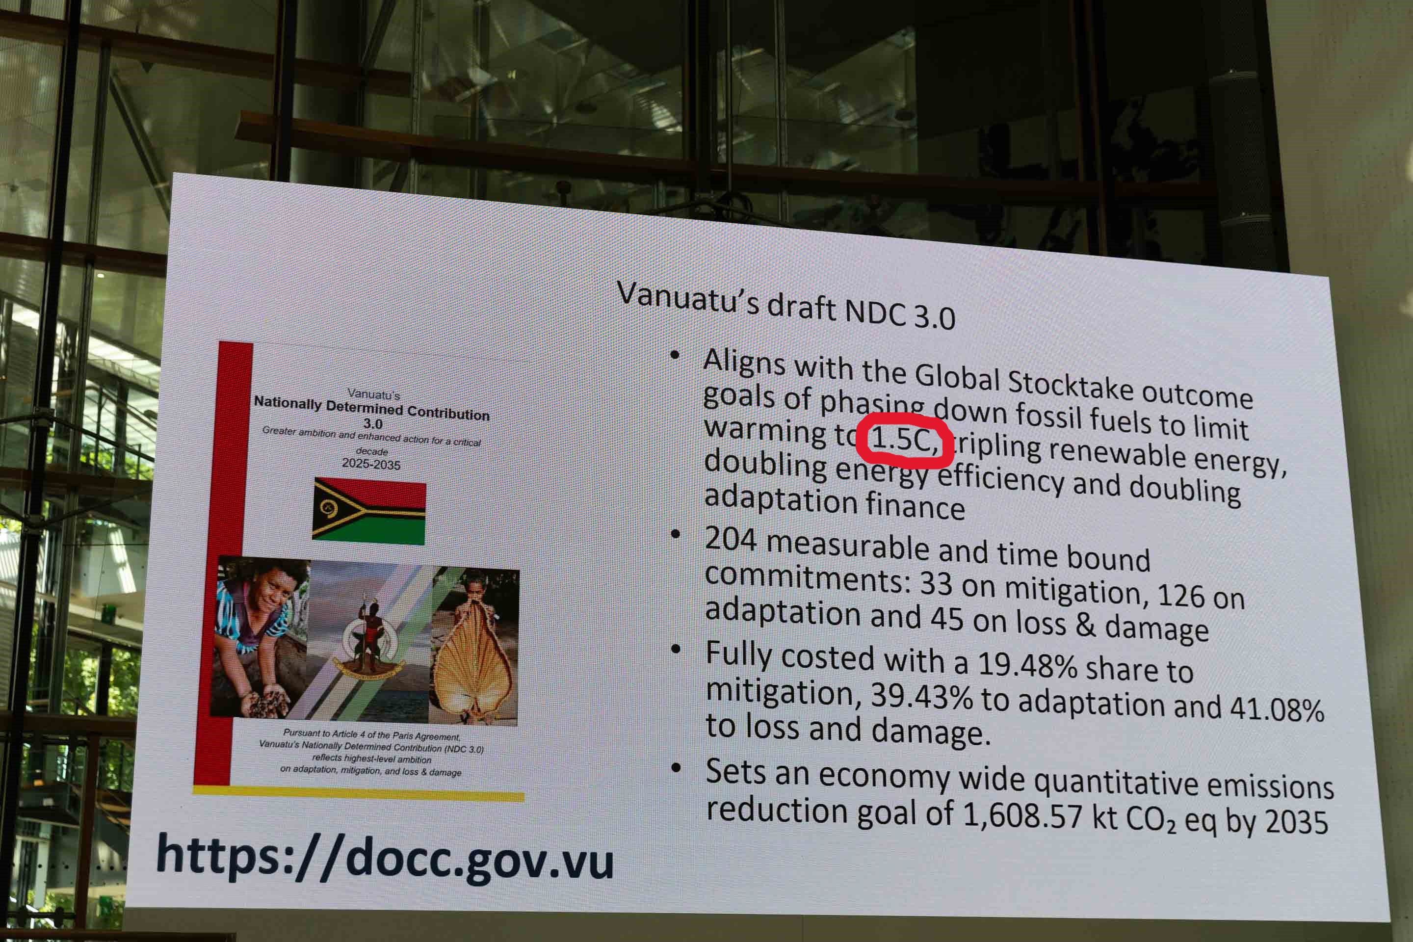
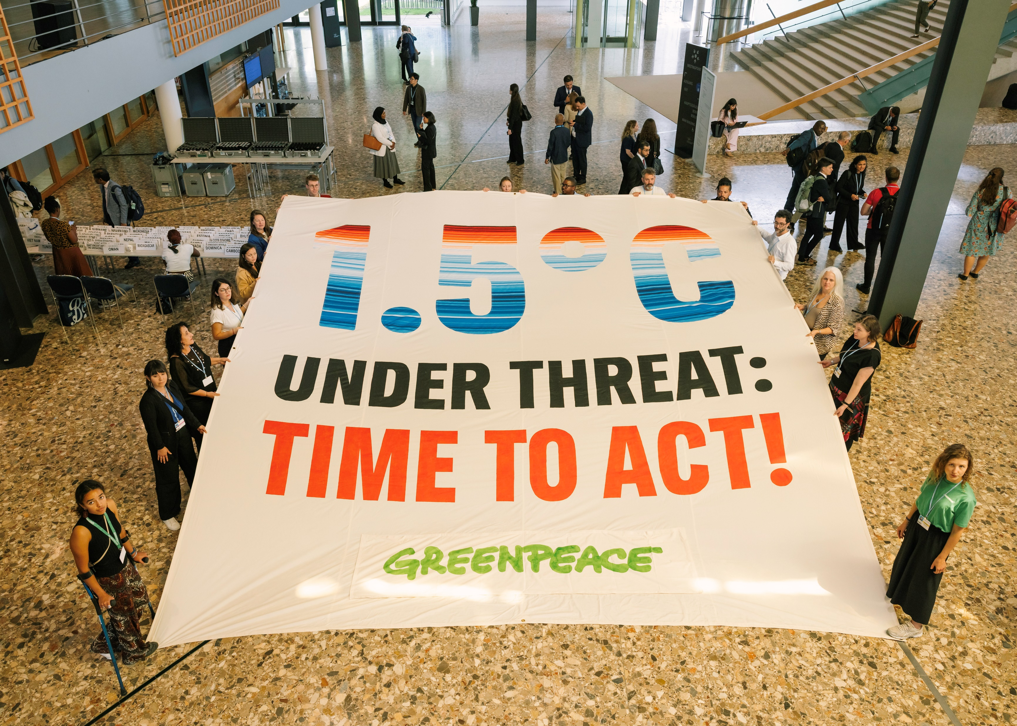
Bonn conference 2025
5/11
Governments¹
Civil society²
Annual mean 1.6C since Feb. 2024*
Need for 20-30 years to know whether > 1.5C
1 Adapted from IISD/ENB - Kiara Worth (June 19, 2025) no. 86
2 Greenpeace - Marie Jacquemin (June 16, 2025) id. GP0SU5UNA
* https://climate.copernicus.eu/surface-air-temperature-february-2024, to June 2025 PS: 1.53C in July 2025

Slide 6
Alternative decision-making procedures
6/11
COP Reform proposals 2023-2025
UN Alternatives
By prominent people¹
By 200 civil society groups²
Global citizens’ assembly³
World federalism
International non-governmental organizations
... and private initiatives
UN reform 1 in 5 success rate
J. Rockström et al. (14 Nov. 2024 and 23 February 2023) Open letter about COP reform https://www.clubofrome.org/cop-reform/
Climate Action Network et al. (June 23, 2025) Reclaiming Climate Justice: United Call for an Urgent Reform of the UN Climate Talks https://www.ciel.org/wp-content/uploads/2025/06/United-Call-to-Action-TheCOPWeNeed.pdf
N. Curato et al. (2023) Global Assembly on the Climate and Ecological Crisis Evaluation Report. University of Canberra. https://researchprofiles.canberra.edu.au/en/publications/global-assembly-on-the-climate-and-ecological-crisis-evaluation-r

Slide 7
Decision-making science: some fields
7/11
Stand-alone / individual
Collective
Quantitative
Fallacies, behavioral economics
Negotiations, game theory
Multiple-attribute group decision-making
Social-choice theory
Public-choice theory
Representation, delegation
Deliberation, collective reasoning
Argumentation, rhetorics
The relevant parts of psychology, sociology, politicology, ...

Slide 8
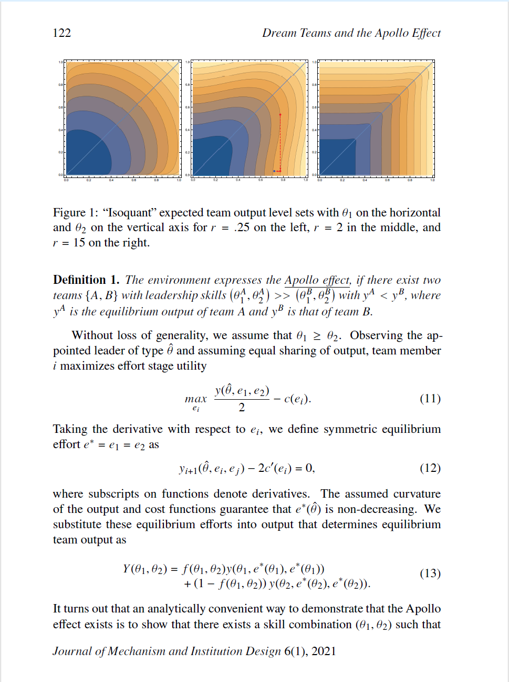
Decision-making science: example
8/11
Paper about mixing members of a``dream team’’ with others for better decision-making.
Alex Gershkov and Paul Schweinzer (2021) Dream teams and the Apollo Effect. Journal of Mechanism and Institution Design, vol. 6, no. 1, pp. 113–148.

Slide 9
Auxiliary bodies
9/11
Verification group
Overview board
Argumentation council

Slide 10
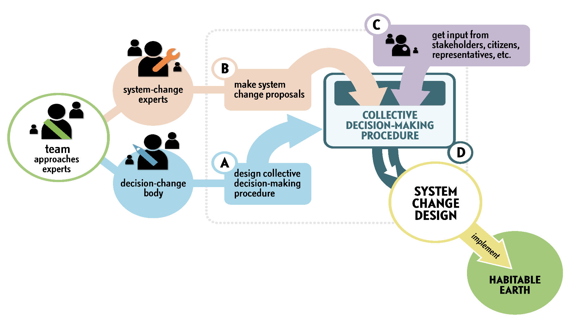
Coordination
10/11

Slide 11
Action
11/11
Find an organization
Endorse
Promote

